Slide 1
Mobile App Statistics
Analyzing Apple App statistics collected from July 2017.
Source: https://www.kaggle.com/ramamet4/app-store-apple-data-set-10k-apps
Collection Date July 2017
Technologies Used: Pandas, Matplotlib, Seaborn
Notes:
7000+ Apple iOS mobile application details
Main details include user ratings, rating counts, currency, price, supporting devices, genre

Slide 2
I did not have many preconceived notions when it came to mobile apps.
I had to look up what cont_rating was.
I was not surprised to see that there are more mobile game apps than any other category
I was surprised to see a price for one shopping app. When you think of a shopping app you think of amazon or ebay.
I don’t remember ever seeing any app at 300 dollars. I suppose it was not that surprising that it’s an education app.

Slide 3
Quick Glance

Slide 4
Checking my Data
Have not found any null characters or NAN
The non English text has been my only real aversion

Slide 5
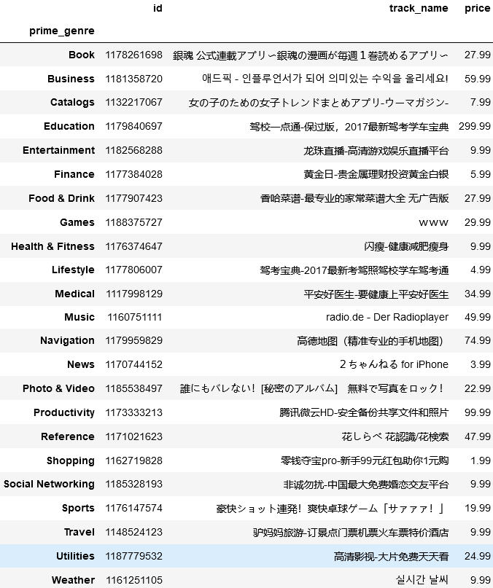
Cleaning
For each genre these are the highest priced apps.
There are over 7000 records and I knew I wanted to try and tackle translating these.

Slide 6
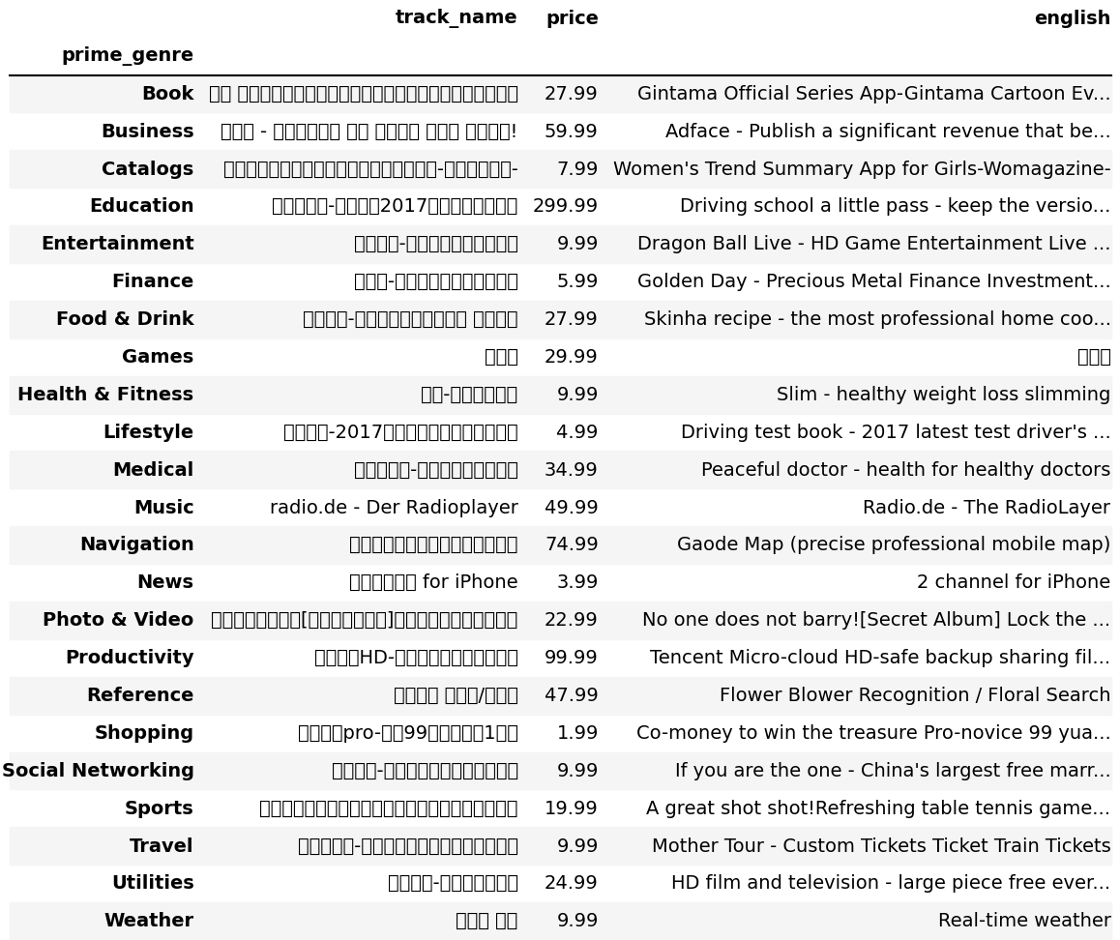
Comparison

Slide 7
Analyze
I used Matplotlib and Seaborn to analyze and graph some of what I found.

Slide 8
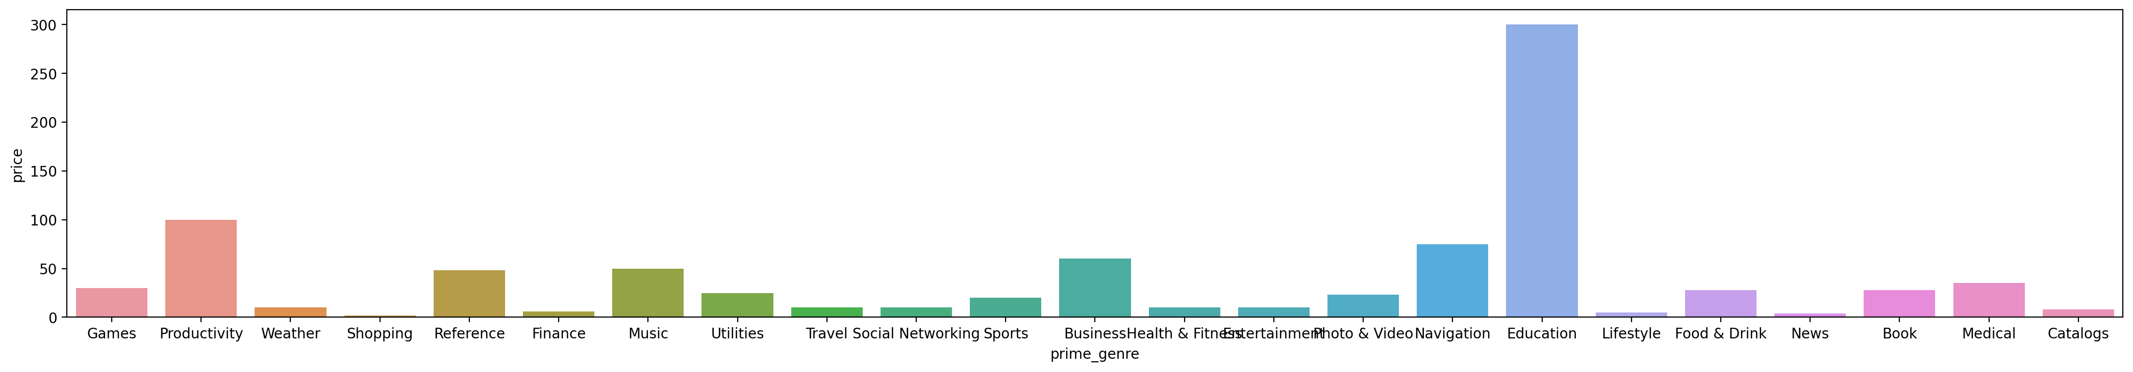
Findings
Notes:
What surprised me when I did a search to see what was the highest priced app in each category

Slide 9
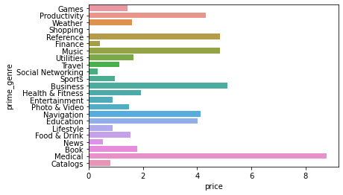
Average price for apps
Notes:
But also the average price for medical apps was much higher than education

Slide 10
Finding a DataSet that I could utilize
I adjusted my final project based on a dataset that I could find that correlated with technology in some way.

Slide 11
Challenges
Hard to find datasets on my original ideas
Many data sets only had a few columns others were behind a paywall
Trying to update a whole column caused timeouts.
Trying to learn different ways to export images without using save as

Slide 12
Room for improvement
Google translate – Looking forward to using a translate library more often in the future and automate like a pro.

Slide 13
Further research…
evaluate if the number of language supported has any effect on user rating or rating content total.

Slide 14
I had fun with this
I had room to ask myself silly questions
I learned a little of what works and doesn’t work

